Slide 1


Ferri Lab Presentation
Quang Le
04/13/2021

Slide 2

Table of Contents
Inserting Pattern in Rhapsody
Recap
Data Scraping
Making Sense of Data Features
Different Price Models
Conclusion

Slide 3
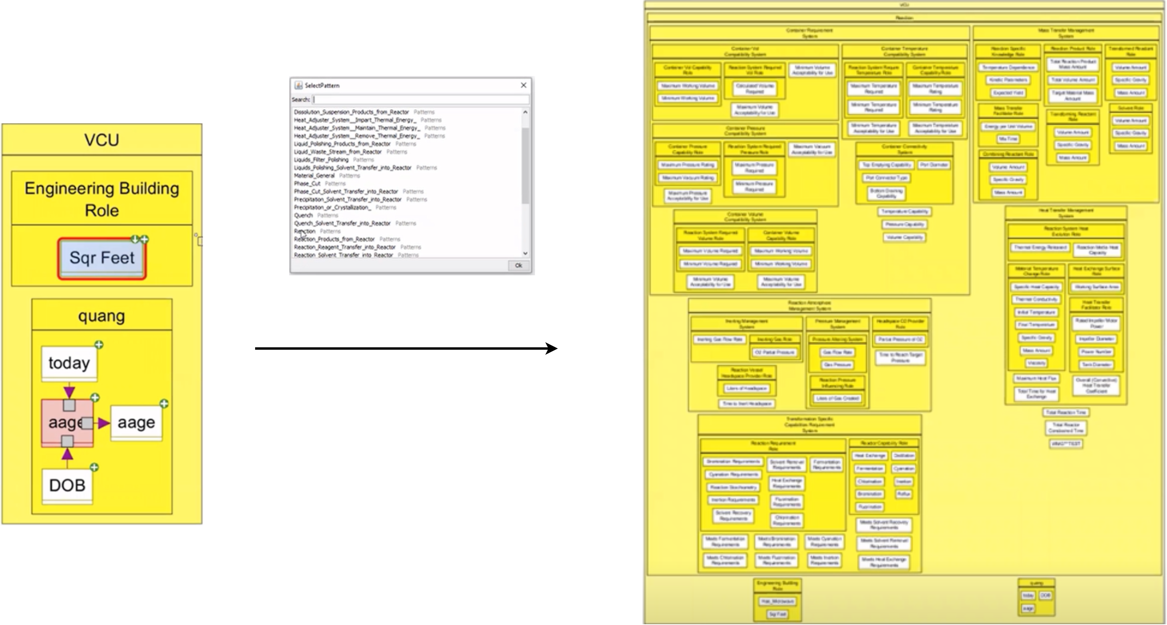
Inserting Pattern In Rhapsody

Slide 4
Table of Contents
Inserting Pattern in Rhapsody
Recap and Changing Direction
Data Scraping
Making Sense of Data Features
Different Price Models
Conclusion

Slide 5
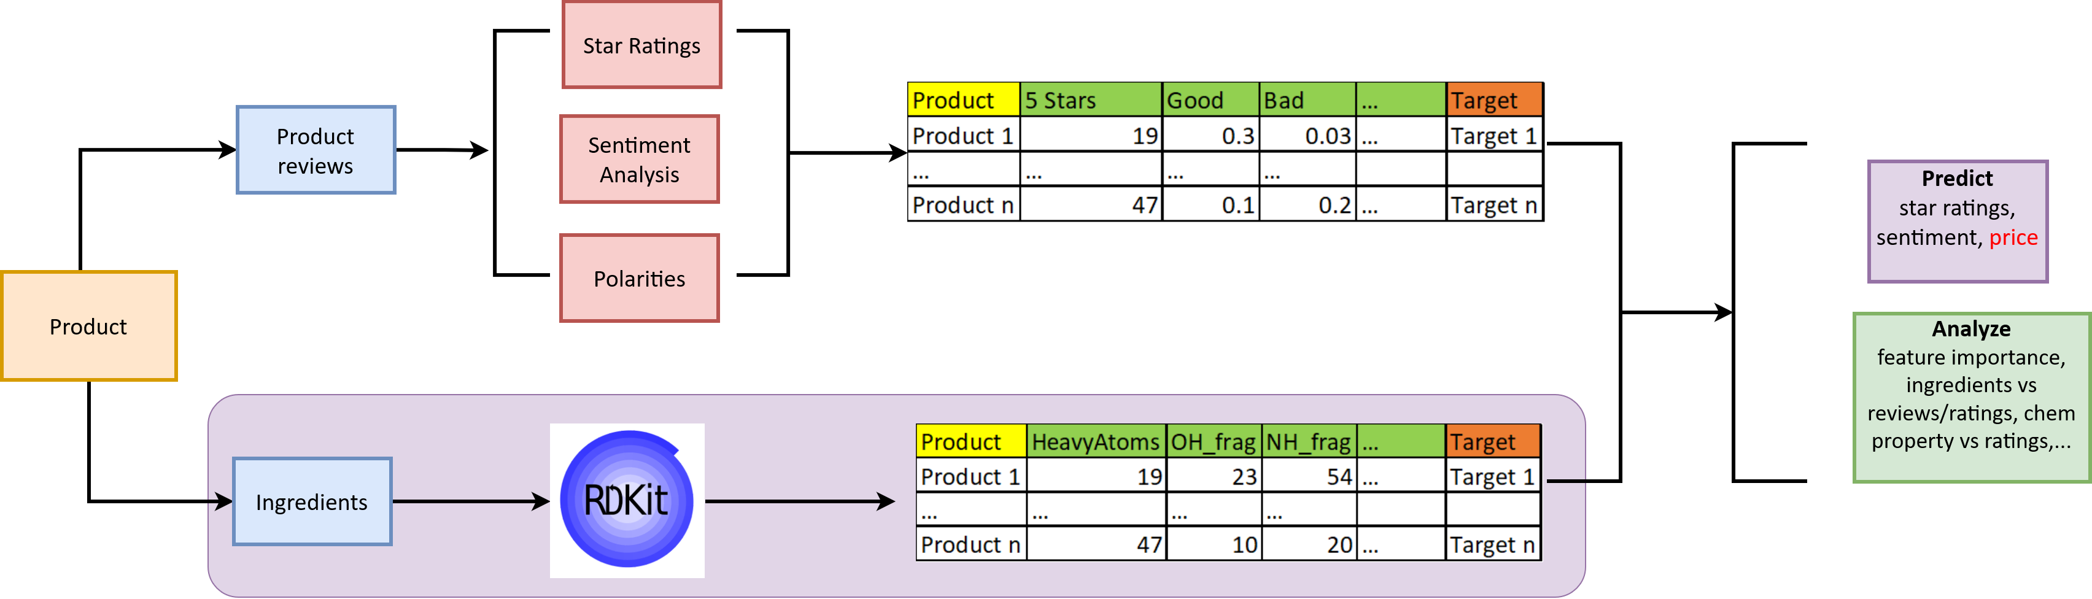
Recap and Changing Direction
Notes:
Intro on the concept of consumer perception.
This schema presents our general hypothesis on what affects consumer perception
Explain why we want to reduce the problem down to raw materials (abundance in data, much easier to quantify than process and influences, easier to do data science on)

Slide 6
Table of Contents
Inserting Pattern in Rhapsody
Recap
Data Scraping
Making Sense of Data Features
Different Price Models
Conclusion

Slide 7
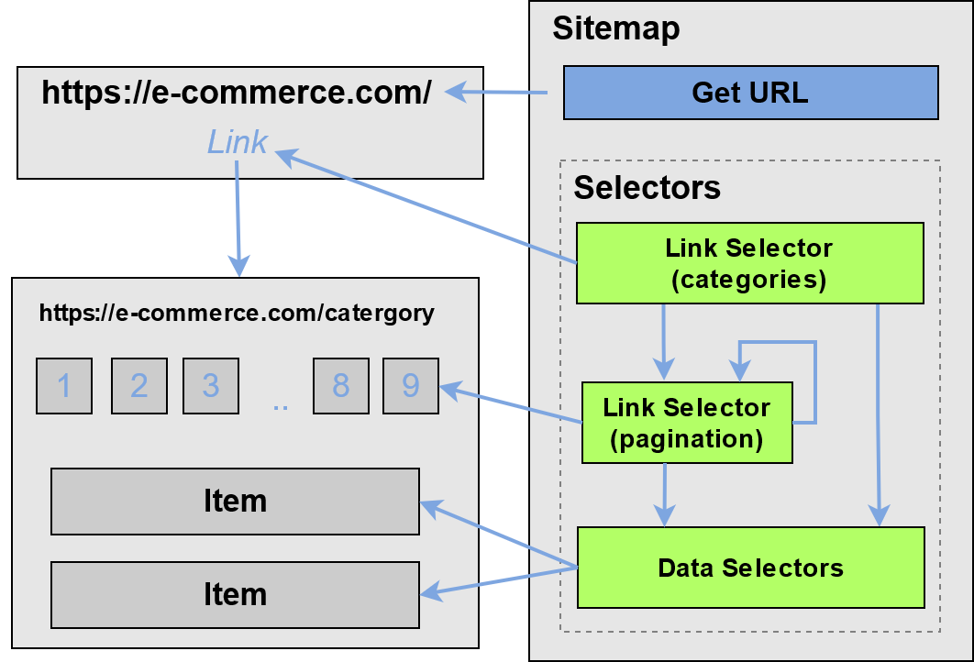
Data Scraping (Theoretically)
Notes:
Explain the concept of data featurization and how it relates to machine learning
Examples: Molecules, pictures, … (Explain a bit about how rdkit can featurize molecules)
Talk about the complexity in featurizing consumer products (there are many things that make up a product (labels, reviews, ingredients, advertisement, …)
and each of them require a different set of skills and tools to extract. It is also difficult to create a generalizable way to featurize them

Slide 8
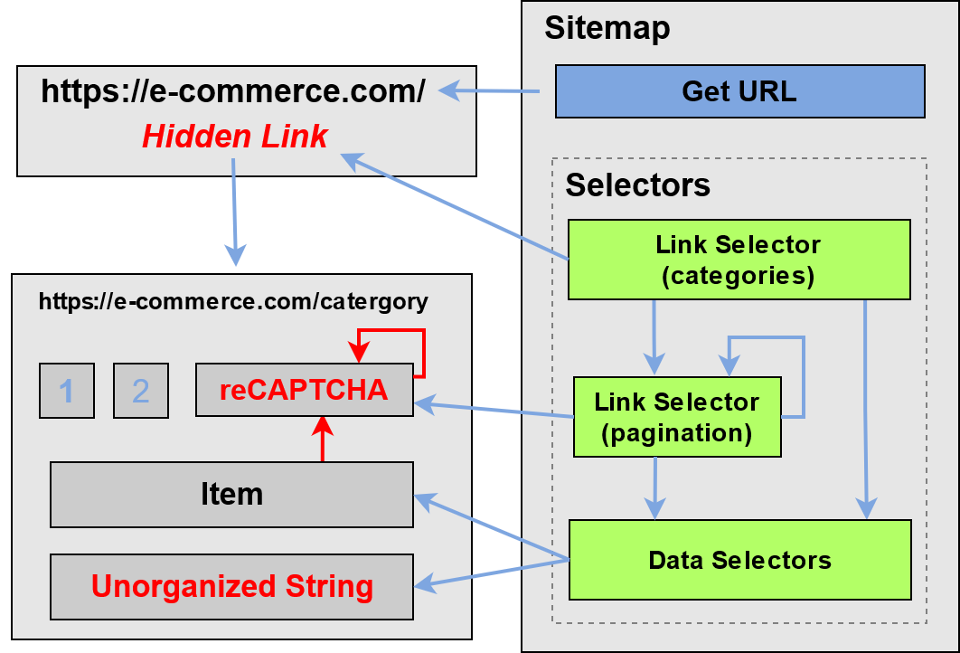
Data Scraping (Reality)
Notes:
Explain the concept of data featurization and how it relates to machine learning
Examples: Molecules, pictures, … (Explain a bit about how rdkit can featurize molecules)
Talk about the complexity in featurizing consumer products (there are many things that make up a product (labels, reviews, ingredients, advertisement, …)
and each of them require a different set of skills and tools to extract. It is also difficult to create a generalizable way to featurize them

Slide 9
Table of Contents
Inserting Pattern in Rhapsody
Recap
Data Scraping
Making Sense of Data Features
Different Price Models
Conclusion

Slide 10
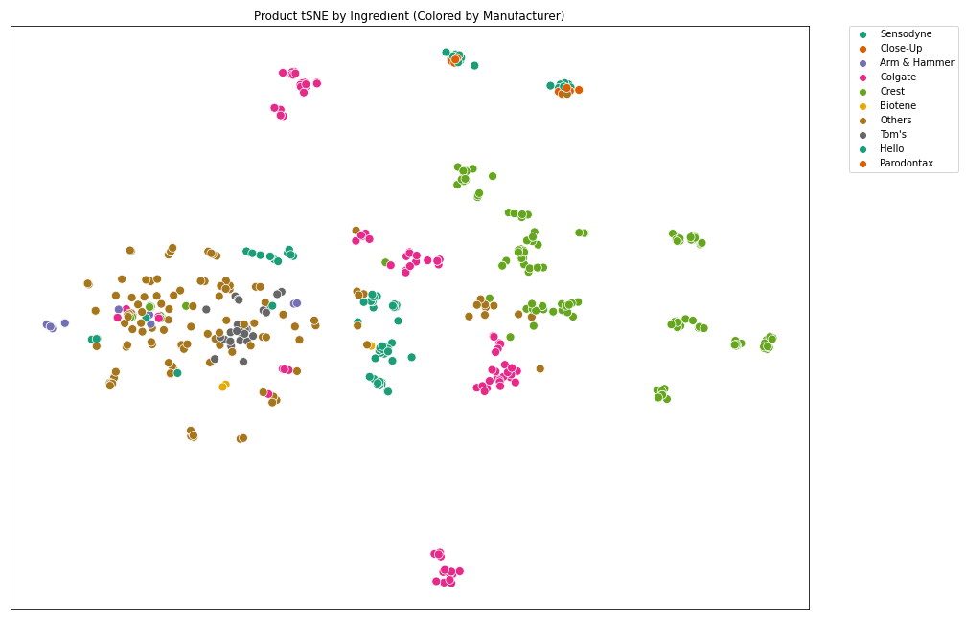
Making Sense of Data Features
Notes:
Explain the concept of data featurization and how it relates to machine learning
Examples: Molecules, pictures, … (Explain a bit about how rdkit can featurize molecules)
Talk about the complexity in featurizing consumer products (there are many things that make up a product (labels, reviews, ingredients, advertisement, …)
and each of them require a different set of skills and tools to extract. It is also difficult to create a generalizable way to featurize them

Slide 11
Table of Contents
Inserting Pattern in Rhapsody
Recap
Data Scraping
Making Sense of Data Features
Different Price Models
Conclusion

Slide 12
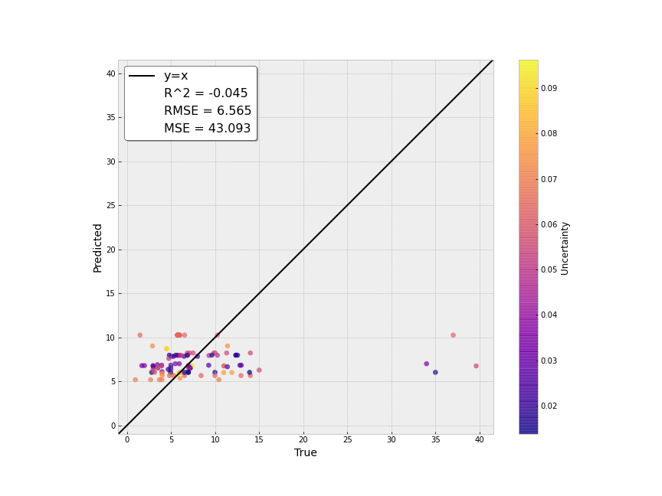
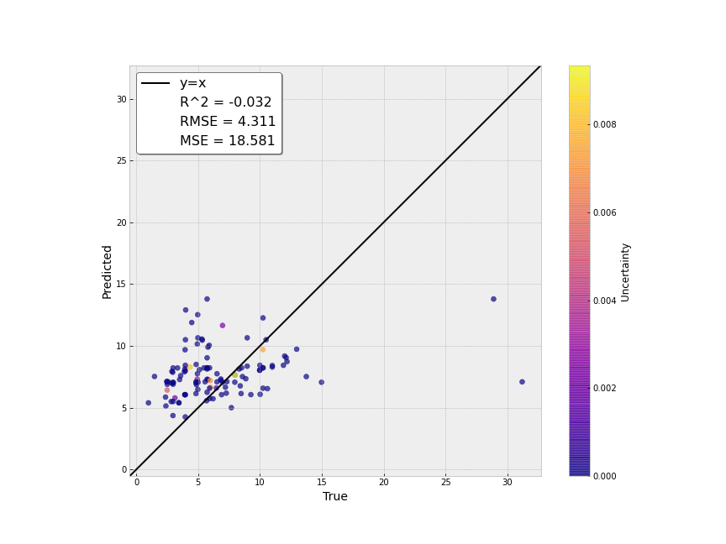
Price Prediction
Graph 1: Price Prediction Using Rdkit Featurization
Graph 2: Price Prediction Using Manufacturer + Ingredients Featurization
Notes:
Explain the concept of data featurization and how it relates to machine learning
Examples: Molecules, pictures, … (Explain a bit about how rdkit can featurize molecules)
Talk about the complexity in featurizing consumer products (there are many things that make up a product (labels, reviews, ingredients, advertisement, …)
and each of them require a different set of skills and tools to extract. It is also difficult to create a generalizable way to featurize them

Slide 13
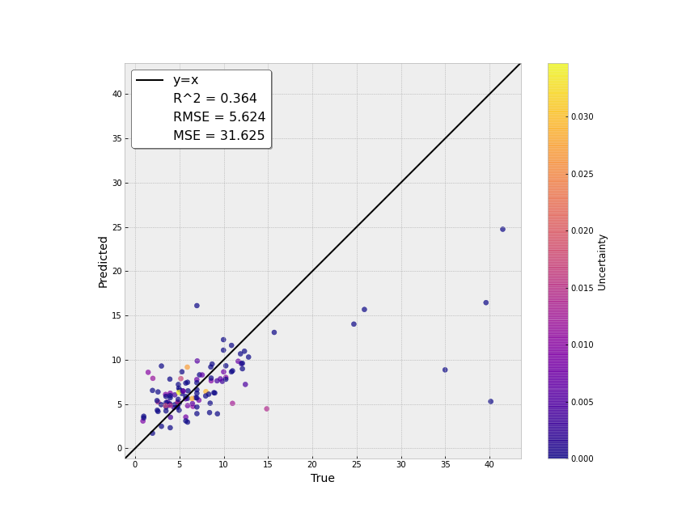
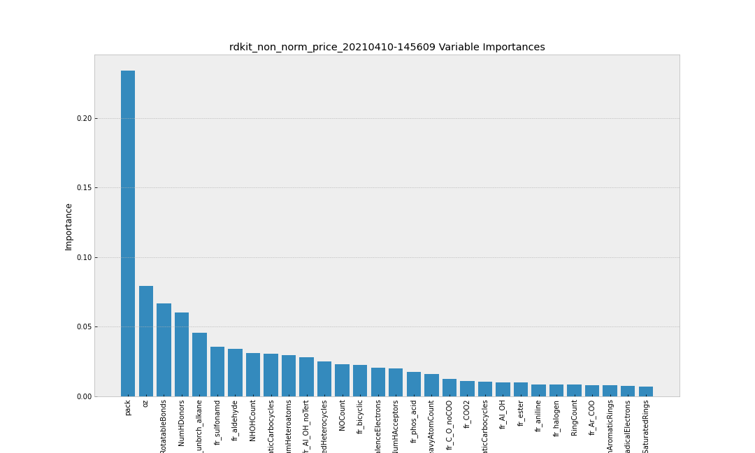
Price Prediction Rdkit + Pack + Oz
Graph 3: Price Prediction Using Rdkit + Pack + Oz Featurization
Graph 4: Variable Importance Graph
Notes:
Explain the concept of data featurization and how it relates to machine learning
Examples: Molecules, pictures, … (Explain a bit about how rdkit can featurize molecules)
Talk about the complexity in featurizing consumer products (there are many things that make up a product (labels, reviews, ingredients, advertisement, …)
and each of them require a different set of skills and tools to extract. It is also difficult to create a generalizable way to featurize them

Slide 14
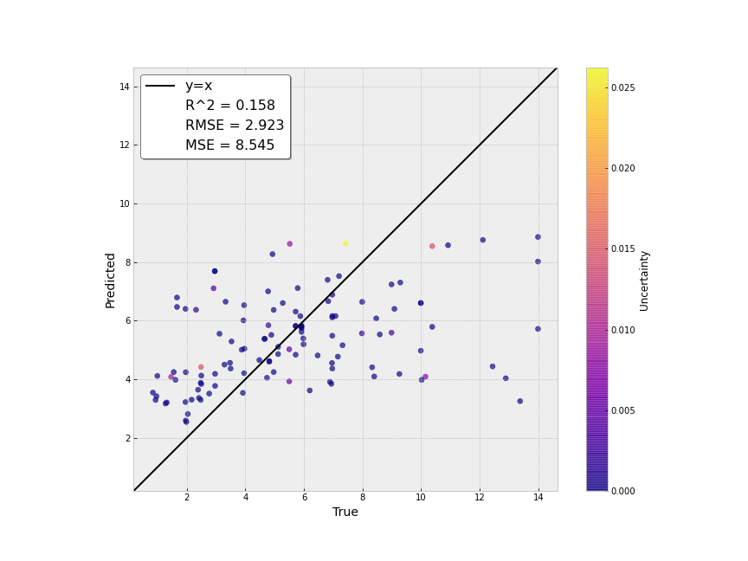

Price/Pack Prediction
Graph 5: Price/Pack Prediction Using Rdkit + Oz + Pack Featurization
Graph 6: Price/Pack Prediction Using Manufacturer + Ingredients Featurization
Notes:
Explain the concept of data featurization and how it relates to machine learning
Examples: Molecules, pictures, … (Explain a bit about how rdkit can featurize molecules)
Talk about the complexity in featurizing consumer products (there are many things that make up a product (labels, reviews, ingredients, advertisement, …)
and each of them require a different set of skills and tools to extract. It is also difficult to create a generalizable way to featurize them

Slide 15
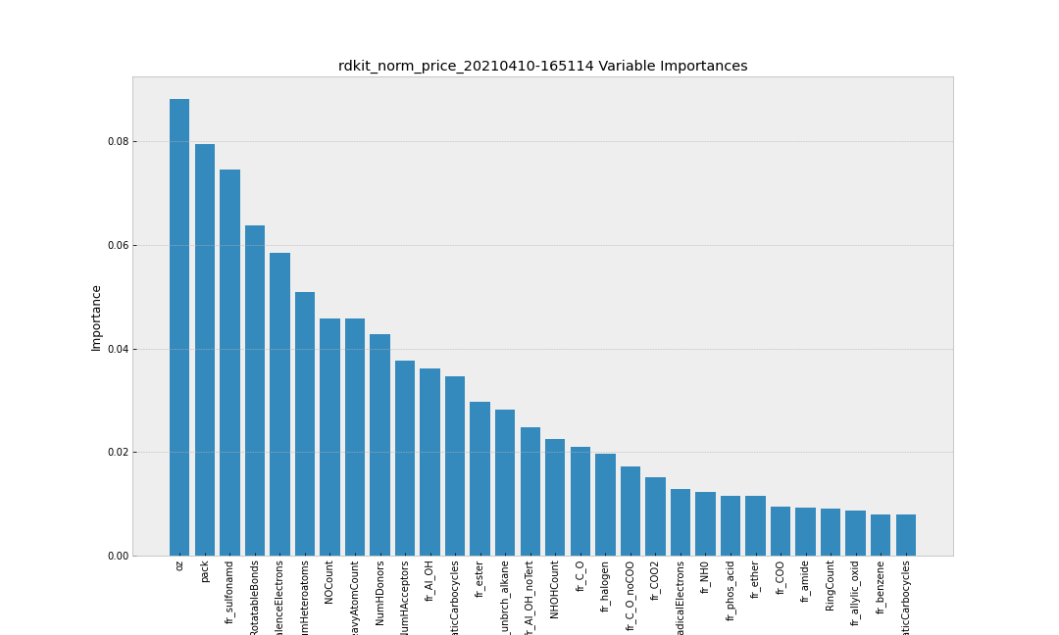
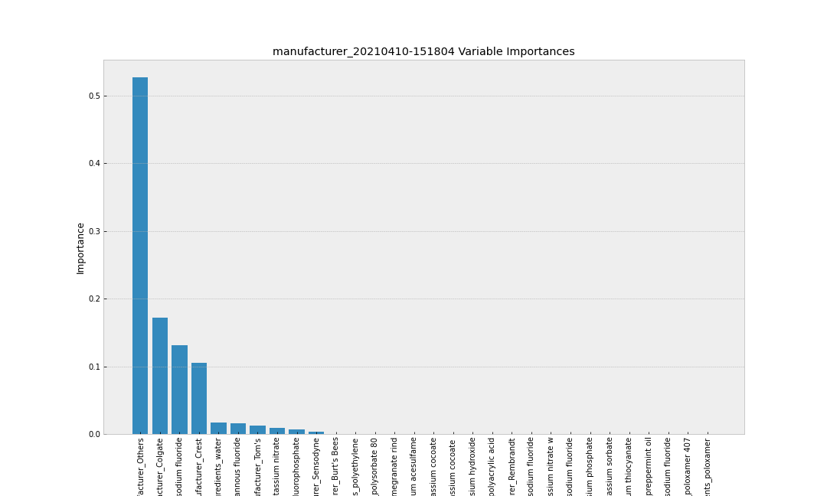
Price/Pack Variable Importance
Graph 5: Price/Pack Variable Importance Using Rdkit + Oz + Pack Featurization
Graph 6: Price/Pack Variable Importance Manufacturer + Ingredients Featurization
Notes:
Explain the concept of data featurization and how it relates to machine learning
Examples: Molecules, pictures, … (Explain a bit about how rdkit can featurize molecules)
Talk about the complexity in featurizing consumer products (there are many things that make up a product (labels, reviews, ingredients, advertisement, …)
and each of them require a different set of skills and tools to extract. It is also difficult to create a generalizable way to featurize them

Slide 16
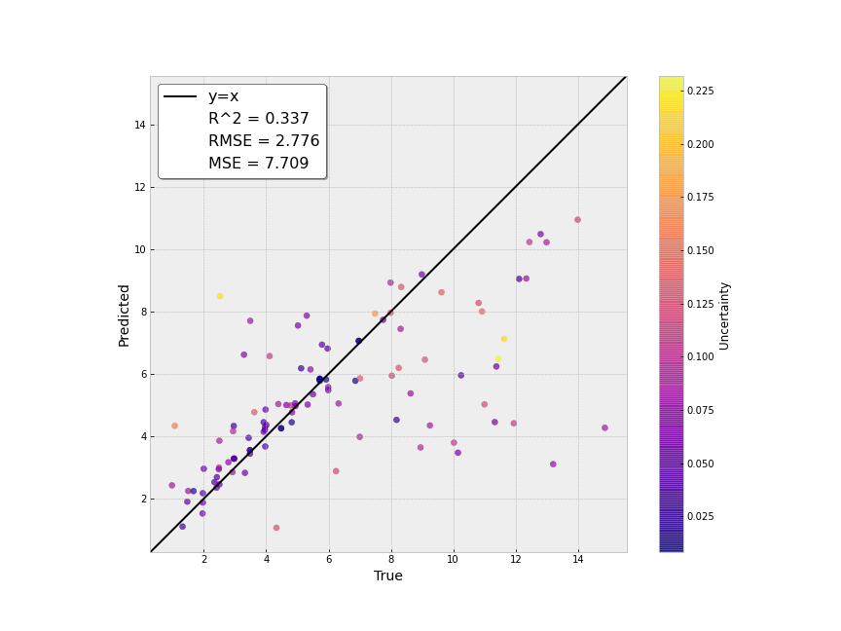
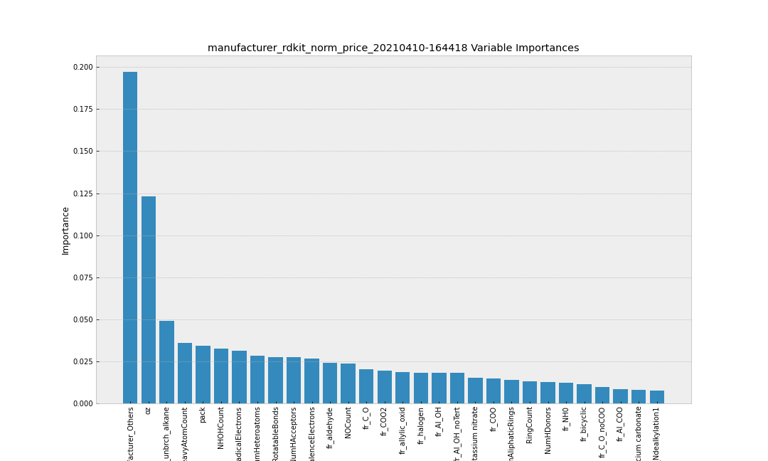
Price/Pack Prediction W/ All Features
Graph 7: Price/Pack Prediction Using All Featurization (Best Model)
Graph 8: Price/Pack Prediction Using All Featurization
Notes:
Explain the concept of data featurization and how it relates to machine learning
Examples: Molecules, pictures, … (Explain a bit about how rdkit can featurize molecules)
Talk about the complexity in featurizing consumer products (there are many things that make up a product (labels, reviews, ingredients, advertisement, …)
and each of them require a different set of skills and tools to extract. It is also difficult to create a generalizable way to featurize them

Slide 17
Table of Contents
Inserting Pattern in Rhapsody
Recap
Data Scraping
Making Sense of Data Features
Different Price Models
Conclusion

Slide 18
Conclusion
Data scraping is a challenge that we’ll continue to face in this project
It is important to make sense of your featurization method
Results aren’t promising but we’re heading in the right direction
For future work, we can combine this with product review to see if it boosts our performance

Slide 19
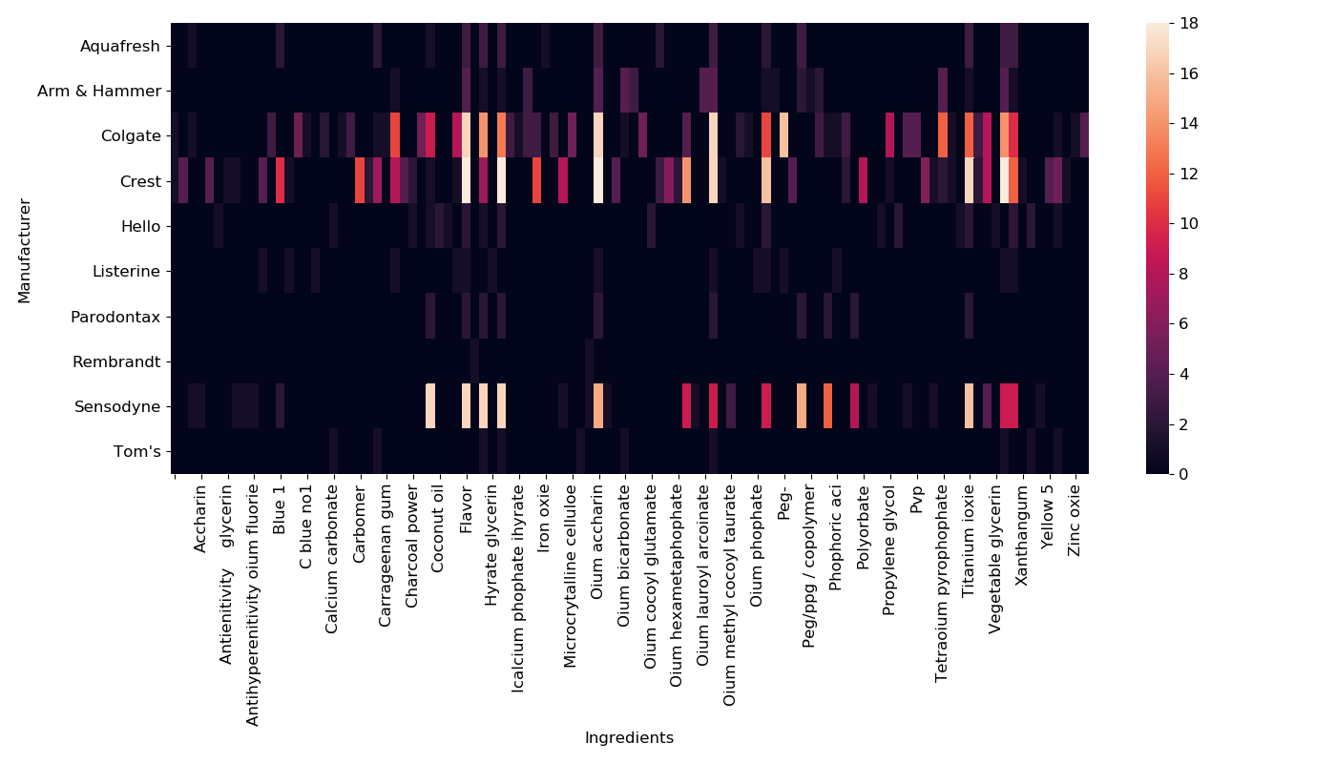
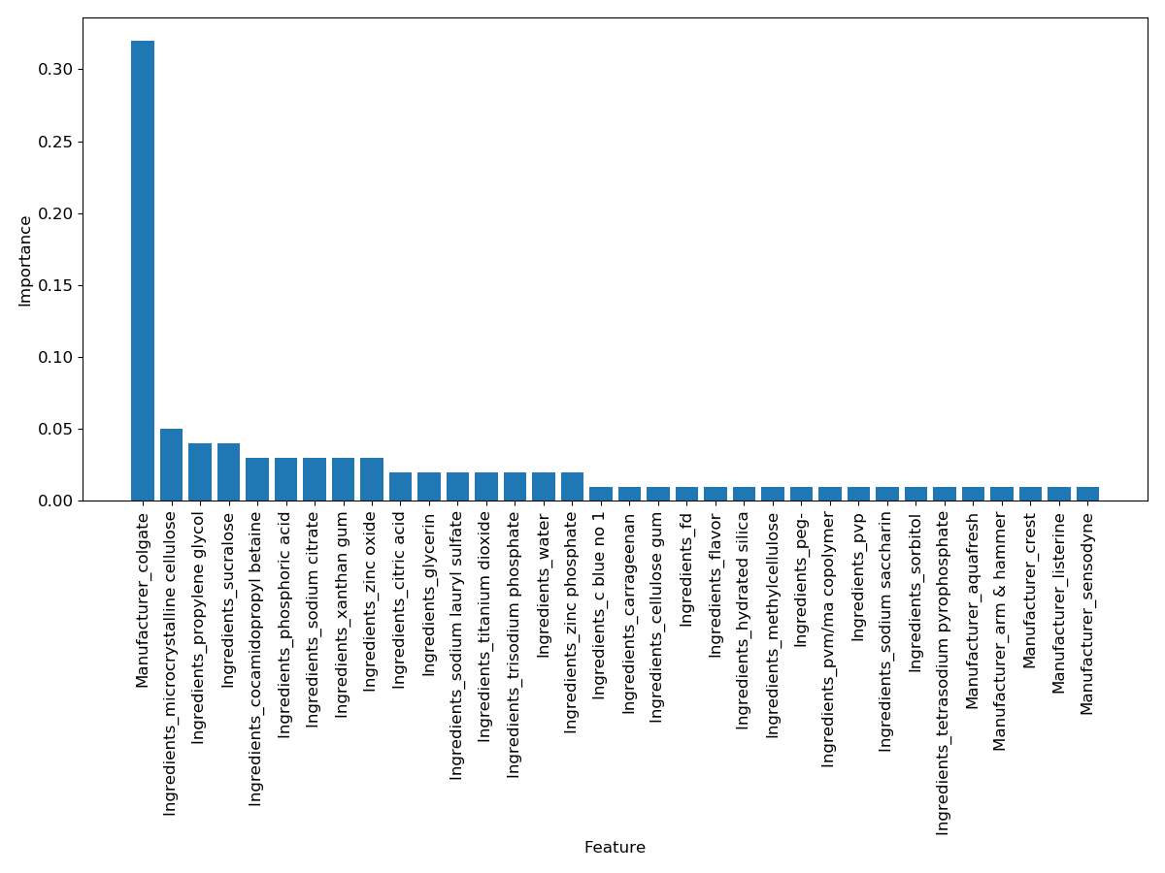
Importance of data (backup)

Slide 20
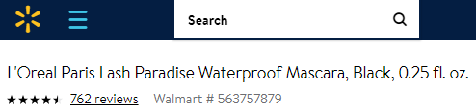

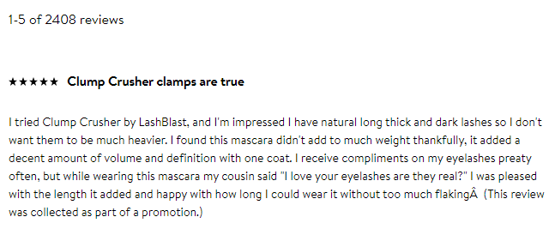
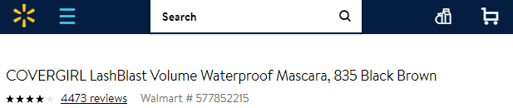
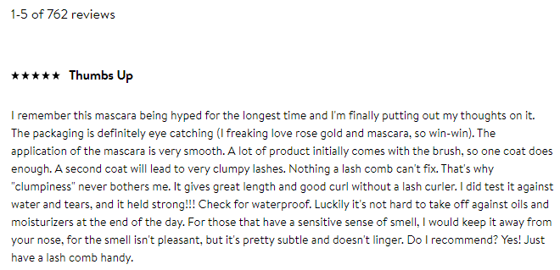

The nightmare that is Product Reviews (back up)

